Slide 1
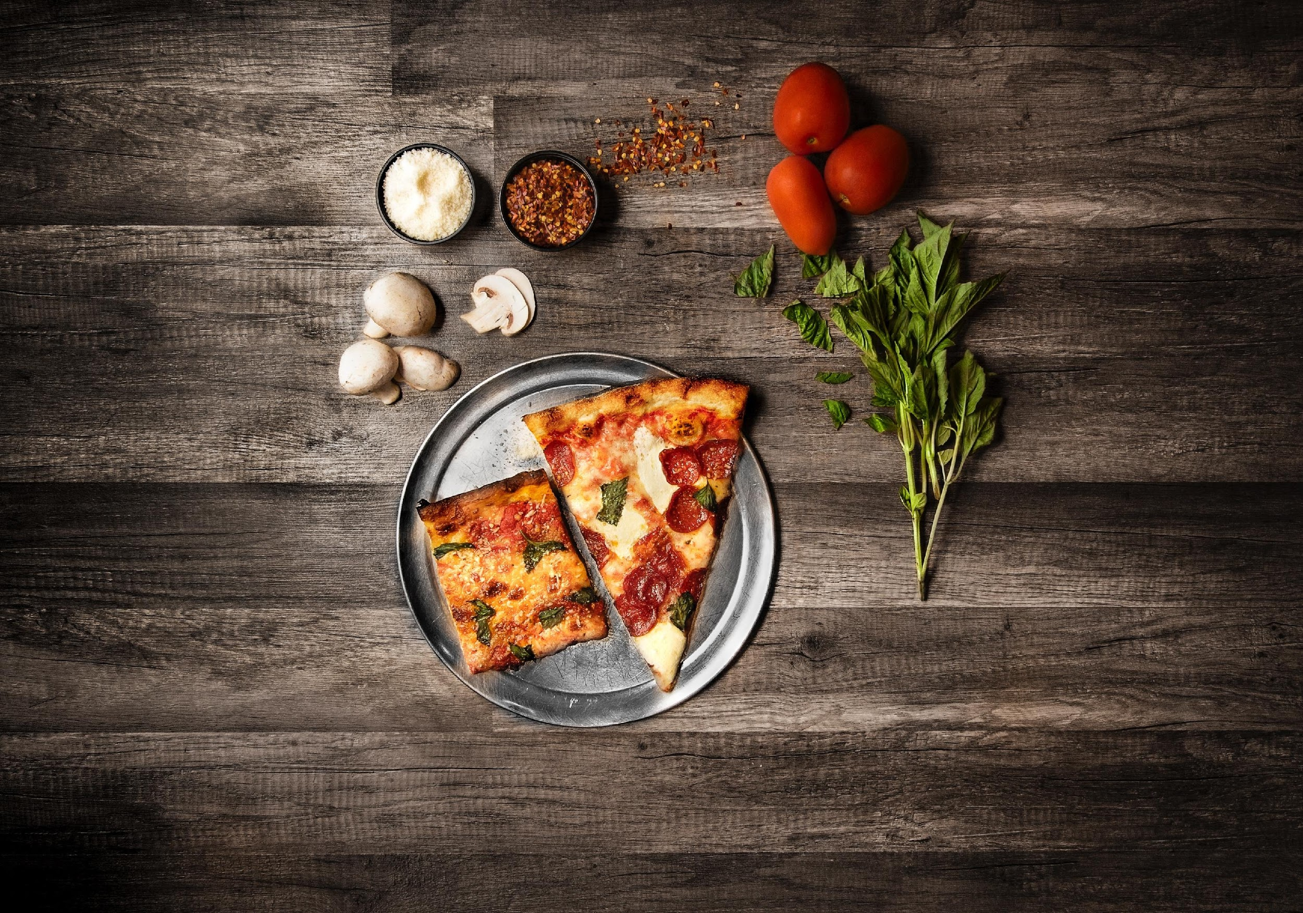

Case Study
Pizzeria Mamma Mia

Slide 2
I. General
Overview
This case study is used to aid students in re-thinking how data can aid in business decision making. On slides 3-4, you can find two perspectives that went into the creation of the case assignment for the BOLT competition.

Slide 3

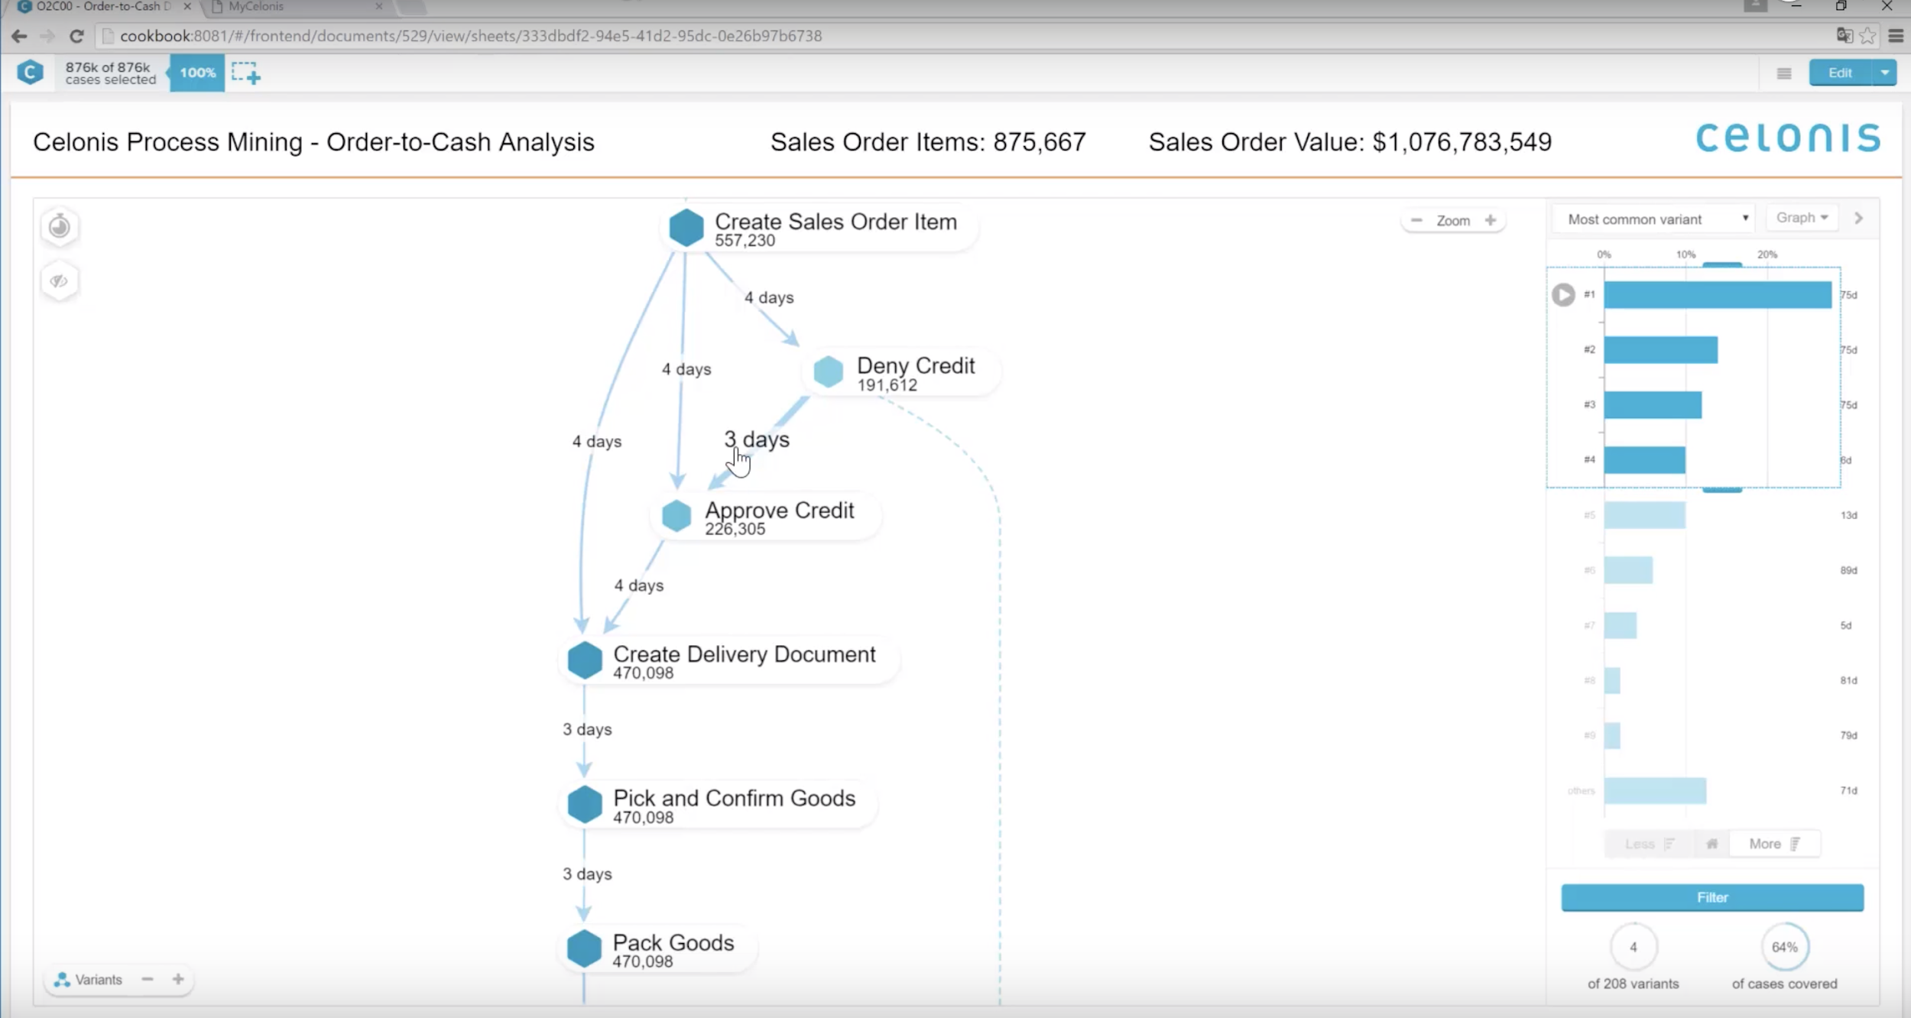
III. Case Problem
Customer Perspective
“We had to wait several hours to then eat
cold pizza. Never ordering here again!”
Anna
First Year Student at the Technical University of Munich
It’s Friday evening and in only two hours the big semester opening party is going to start. A group of freshmen decides to order some pizza before heading out into the night. They order at “Pizzeria Mamma Mia” – a local take-away restaurant. They decide to order online through a delivery service system.
However, after an hour has passed, they still haven’t received the food. Therefore, they call the pizzeria to ask what has happened to their order. They are asked to repeat their order again as their order got lost somehow. Really annoyed, but driven by empty stomachs, they repeat it and hope they get to eat soon.
By the time the pizza arrives, the pizza is cold. That is the final straw, the angry group arranges a heavy discount on the bill with the embarrassed delivery guy and lets him leave without any tip. Baffled by the bad service, they rate the pizzeria with 0 out of 5 stars and leave a negative review.
0 out of 5 Long waiting times and insufficient quality impact customer satisfaction

Slide 4


III. Case Problem
Business Perspective
“My pizza is top quality, but I struggle with providing my customers excellent service. I need something like an
X-ray machine to find out where the problems lies.”
Giovanni
Owner at the
Pizzeria Mamma Mia
The Pizzeria Mamma Mia is selling take-away pizza. The business is generally going well, however, their customer ratings have been very low, and they are making negative profits for some of their deliveries.
The owner of the Pizzeria, Giovanni, is puzzled: “I make my pizza by following the original recipe of my grand grandfather and everyone loves it! Still, customers complain and don’t come back. I wonder if there is some way, I could look behind the processes at the pizzeria to find the problem."
Martin, a business student who works part time at the pizzeria, comes up with an idea that could save the faith of the pizzeria. As part of the student consulting club, he has been using a technology called Process Mining to analyze business processes within companies. He is convinced that the software will work for Giovanni’s pizzeria just as fine as for larger businesses.
Revenue
Key Performance Indicators (KPI) for businesses are revenues and costs. Low revenues and high costs make a business unprofitable.

Slide 5
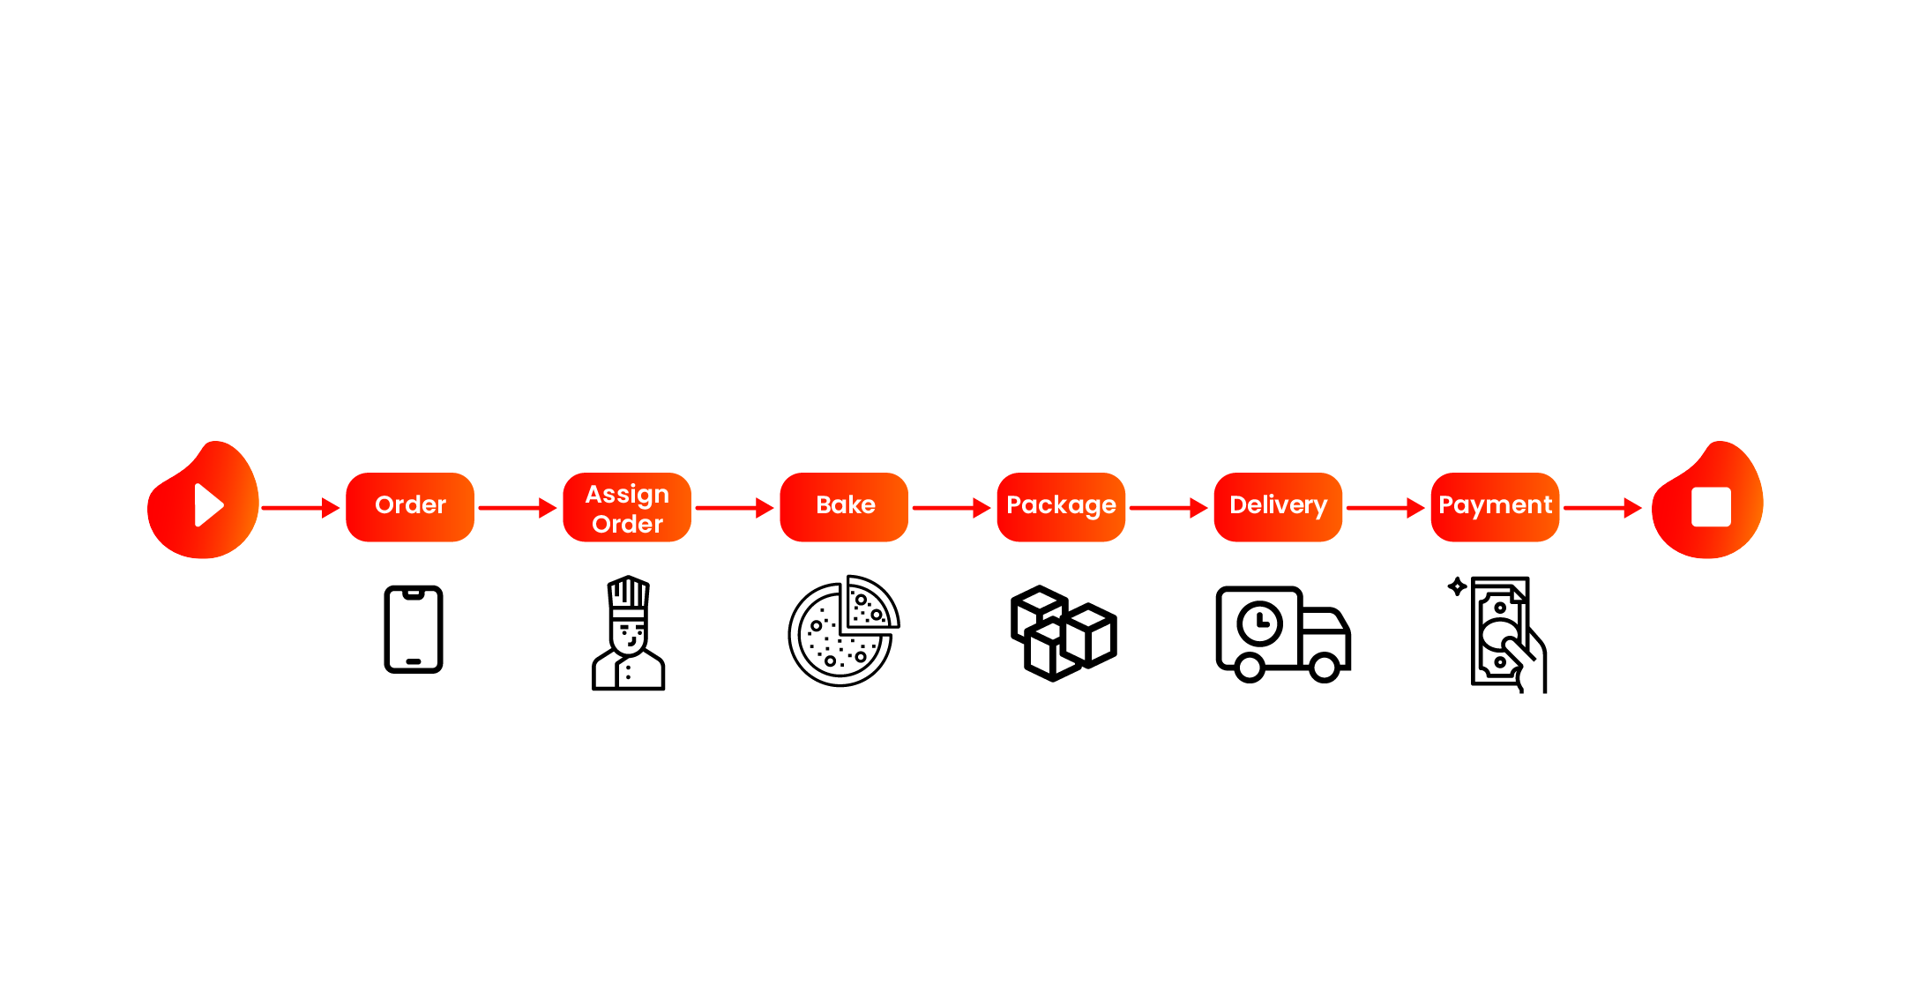

Business Processes at a glance
Martin explains to Giovanni what a process is:
To simplify this definition for Giovanni, he illustrates the pizza delivery process. The following graphic shows how the pizza process could look like but does not necessarily have to.
A business process or business method is a collection of related, structured activities or tasks that in a specific sequence produces a service or product (serves a particular business goal).
Source: Mathias Weske (2012)

Slide 6
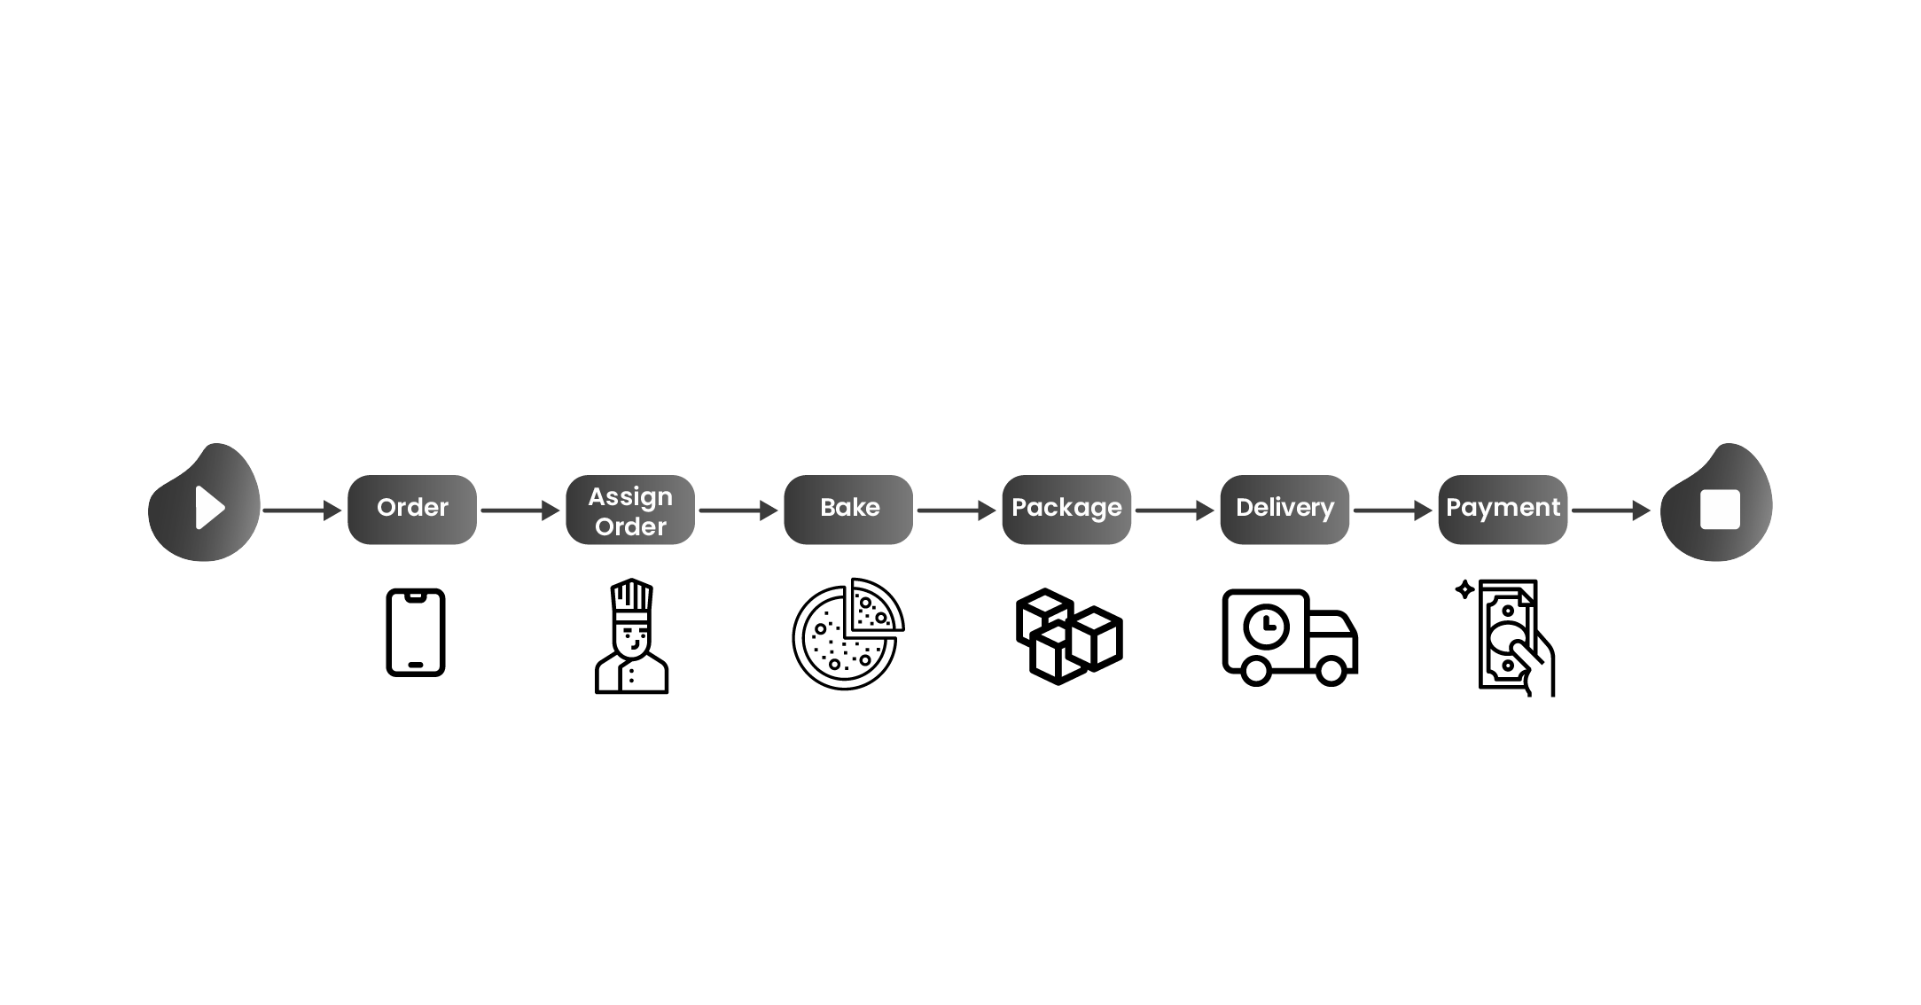





IV. Process Mining Theory
Business Impact of Process Mining
Reduce
Process Cost
Perfect Order
Efficiency
Automation
Increase
Revenue
Speed
and Agility
On-Time Delivery
Throughput time
Reduce
Working Capital
Quality
and Fulfillment
Rework
Rejections
Higher Customer
Satisfaction

Slide 7
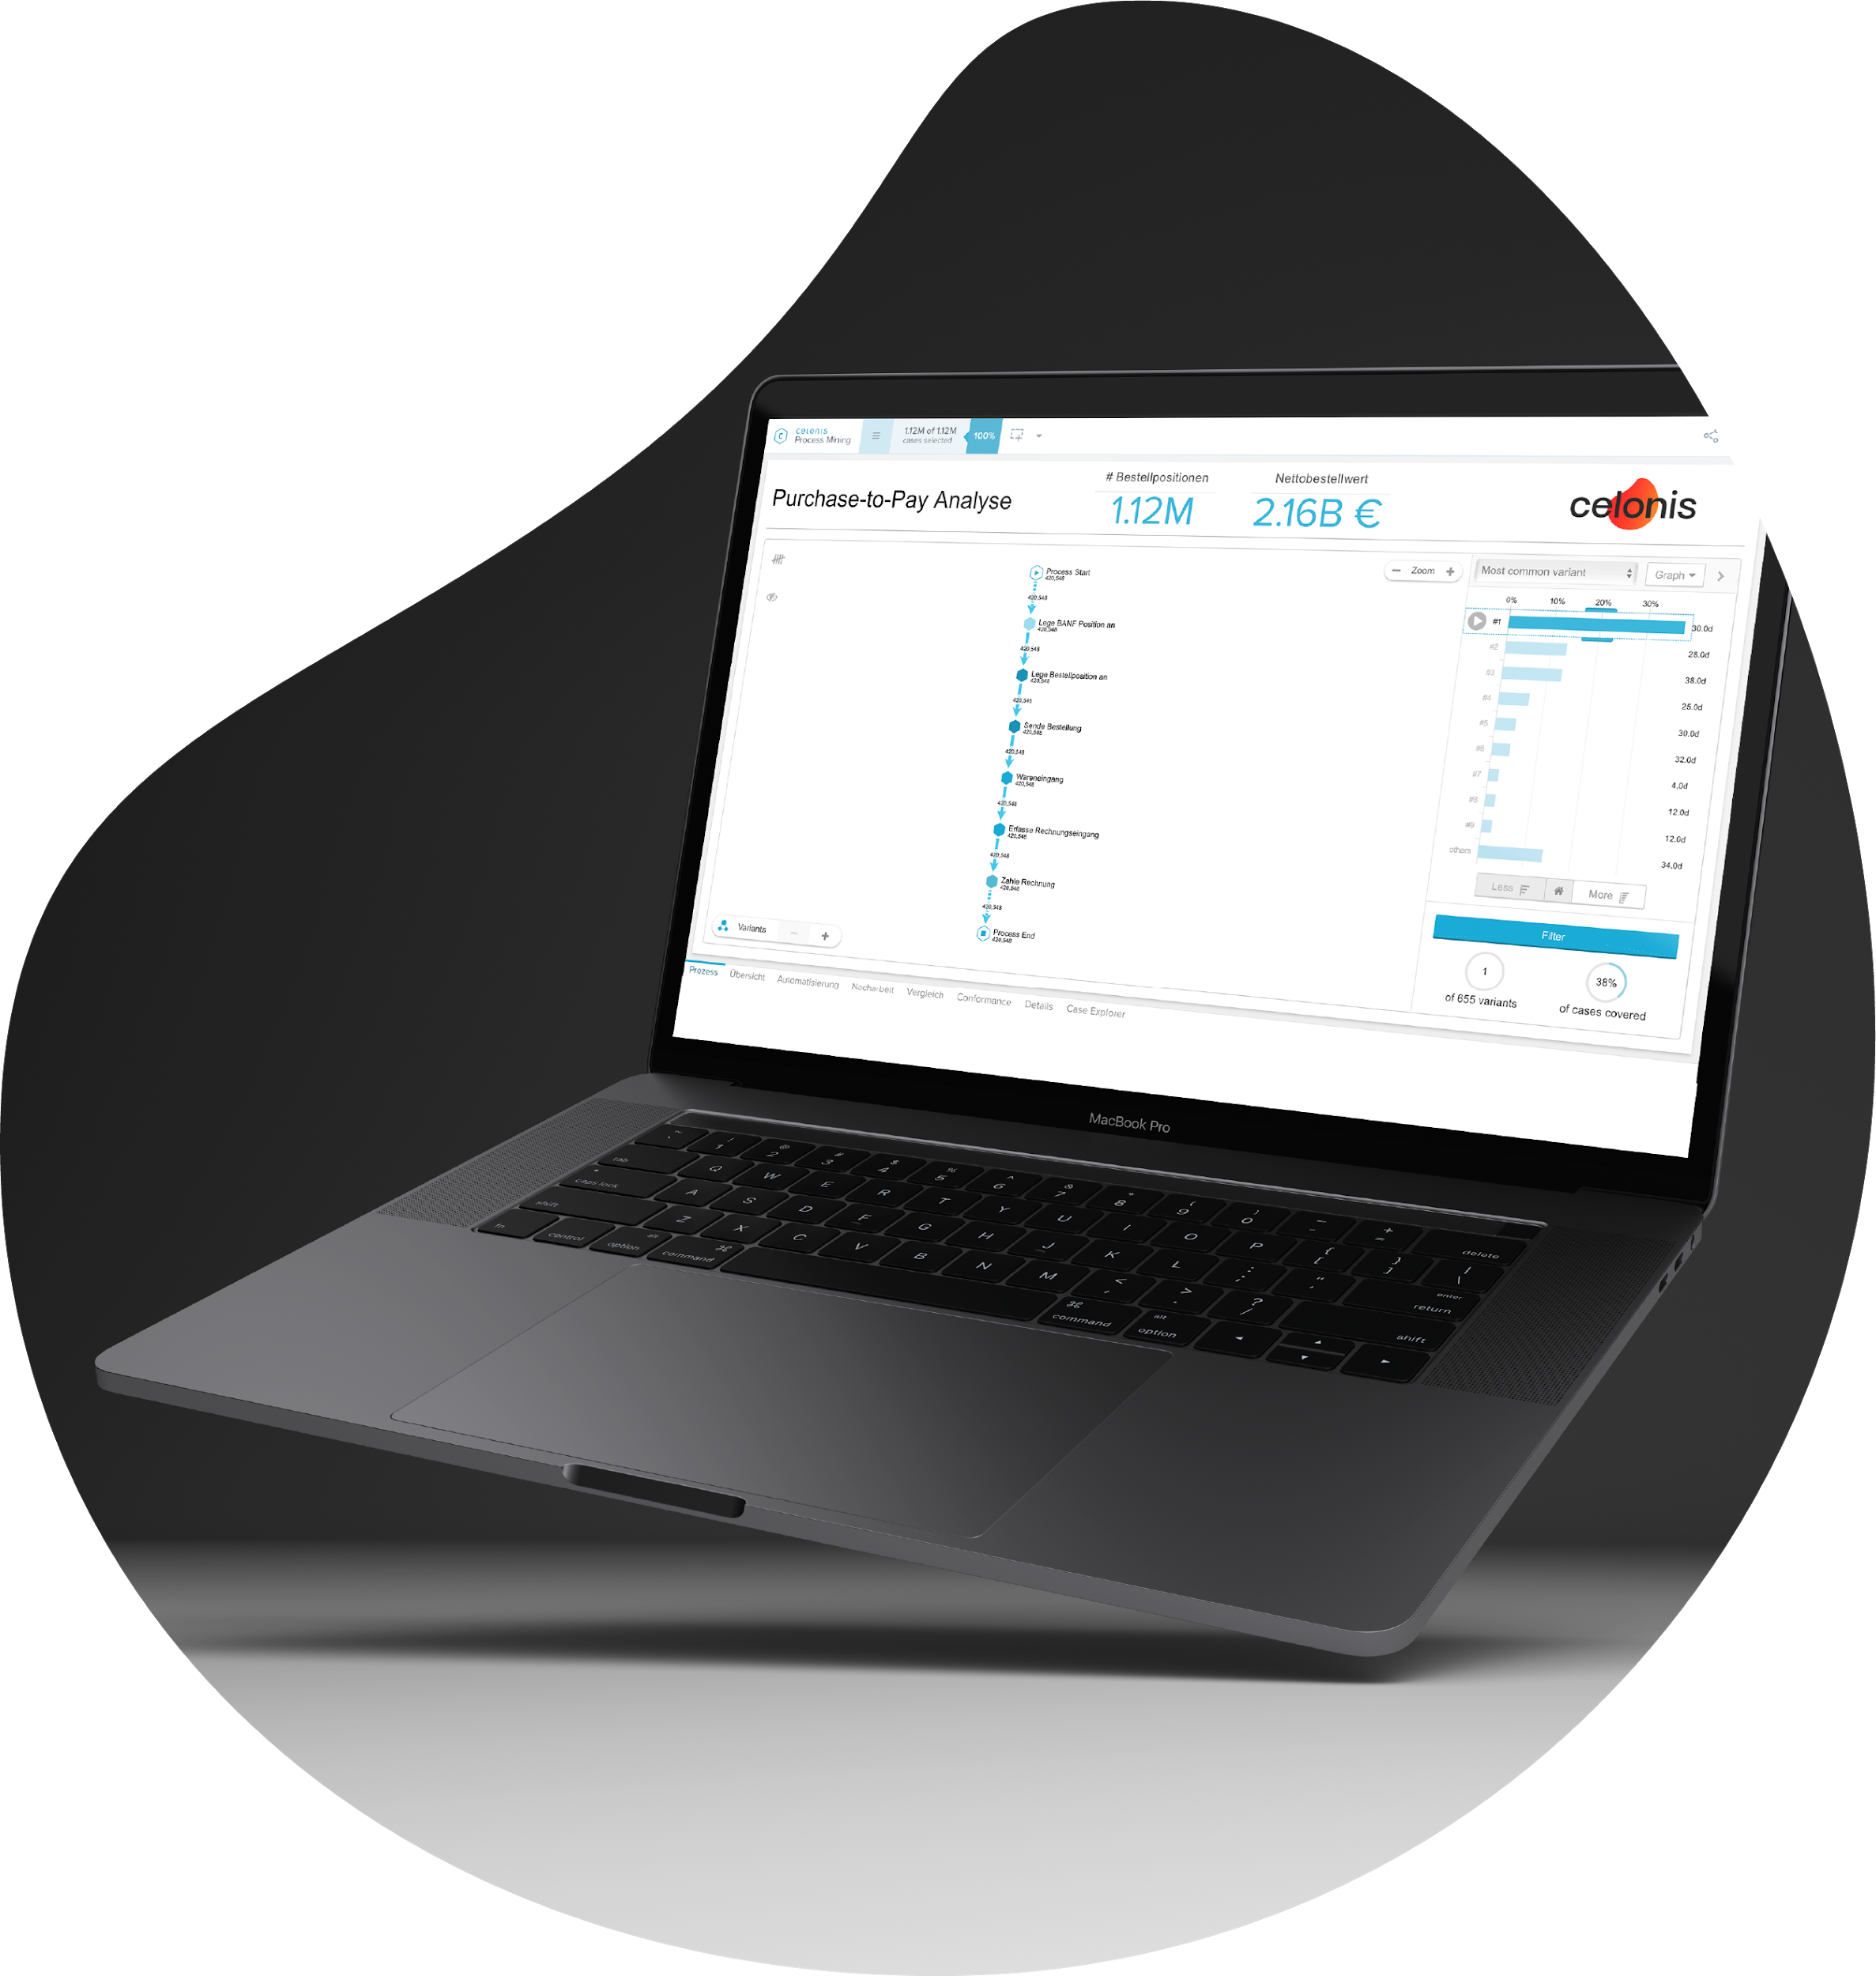
Creating your workspace guide

Slide 8


Start right away!
Access Celonis in three steps
Register for free with your academic e-mail address.
Open the invitation e-mail and click the link.
Access your personal team and start exploring!
www.celonis.com/academic-signup

Slide 9
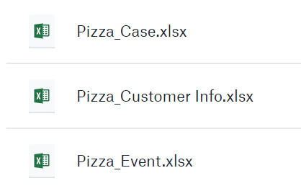
V. Preparation
Pizzeria Mamma Mia – Get the data
Create a new analysis for the pizza process
You are now in the role of a Process Mining Analyst at Pizzeria Mamma Mia. Giovanni asked you to prepare a new analysis to get a deep dive into the pizza delivery times.
Download the data tables for the pizza process.
Upload the pizza data in your license and create the Process Data Model (detailed manual in next slide).
Create a new analysis (via Process Analytics) that helps Giovanni (the viewer of the analysis) to optimize his key performance indicators. You are free to choose appropriate components and designs.
Be creative, add structure to your analysis and create a presentation of your results.
The data files you need can
be found in the dropbox folder

Slide 10

V. Preparation
Upload files
Summary
Open the register event collection
Create a new data pool
Upload the three tables via file upload
Create a Data model
Connect the tables through foreign keys
Create a new workspace within Process analytics
Build your first analysis based on your data model
Or view a video
https://bit.ly/2JKxYG9

Slide 11
V. Preparation
Example Workspace Structure
Details
As an analyst, it is important to create well structured analyses that can be easily interpreted by the viewers
A good analysis starts with a useful title and short explanation of the analysis’ purpose
In the headline, you can add further single KPIs and numbers describing the data set (e.g. the number of cases or the total net value)
The body is the section beyond the headline, which can be seperated by a horizontal line
The body includes various analysis components that help the viewer to understand the process and to drill down the data
Usually, one analysis refers to a specific use case, e.g. process overview, analysis of rework activities or automation.
Example
TITLE
Single KPI1
Single KPI2
Header
Variant or Process Explorer
Analysis component 1
(e.g. OLAP table)
Body
Analysis component 2
(e.g. pie chart)

Slide 12
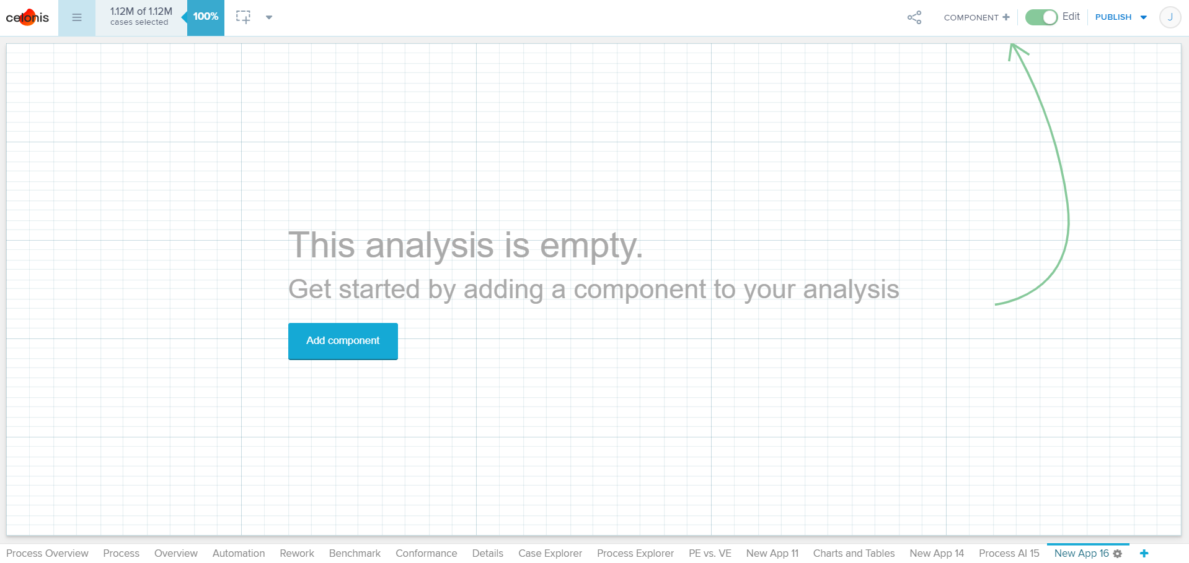
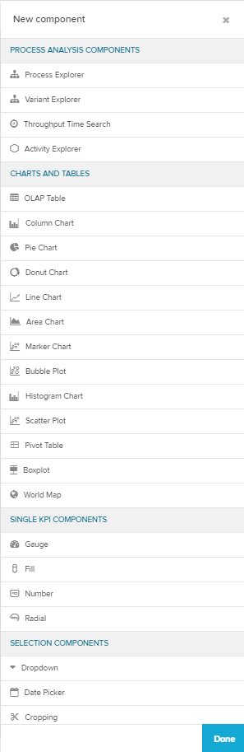
Example Analysis Components
V. Preparation
Details
Celonis has five different categories of components:
Process Components: Visualize your activities and the way the processes flow through them (Process Explorer & Variant Explorer)
Charts and Tables: Plot your data or group, segment and arrange them in tables (OLAP Table, Scatter Plot, Pivot Table, World map, Boxplot)
Single KPI Components: Track your data according to a single KPI
Selection Components: Helps the user create selections
Design Components: Create design elements for your analysis.

Slide 13
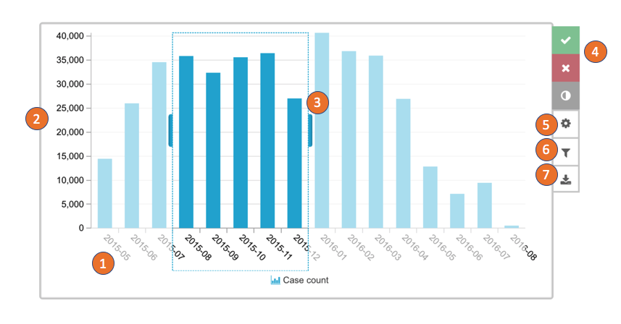
V. Preparation
Details
Charts
Column, line, area and marker charts all behave the same with the visual representation being the only difference:
Dimensions are concatenated and shown on the dimension axis.
KPIs are by default all shown on the primary value axis.
Click on the chart and drag and drop to create a selection.
Confirm, cancel or invert the temporary selection.
Open the component settings. (Only available in the analysis draft)
Open the component filter. (Only available in the analysis draft)
Download the component.
4
3
2
5
6
7
1

Slide 14
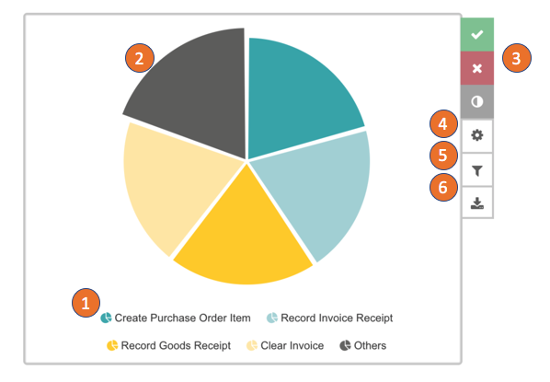
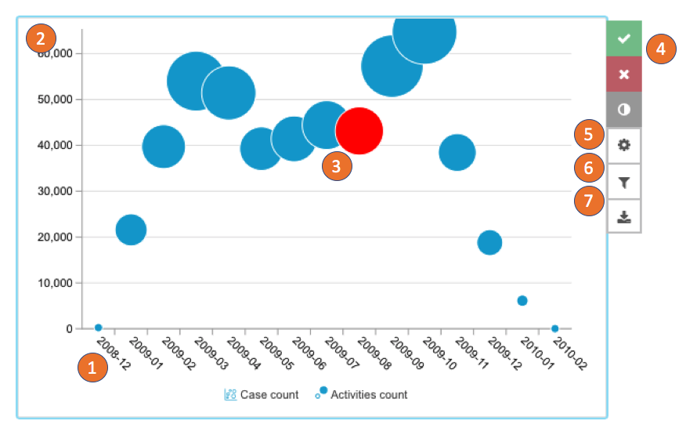
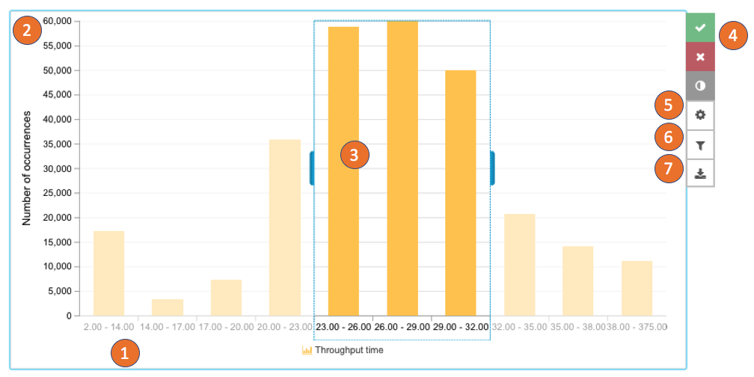
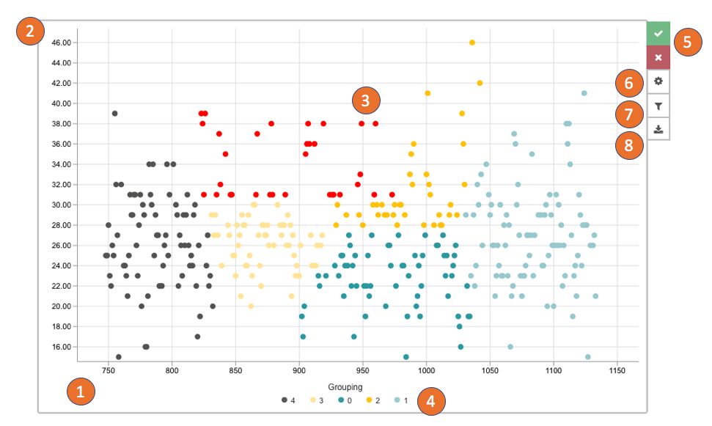
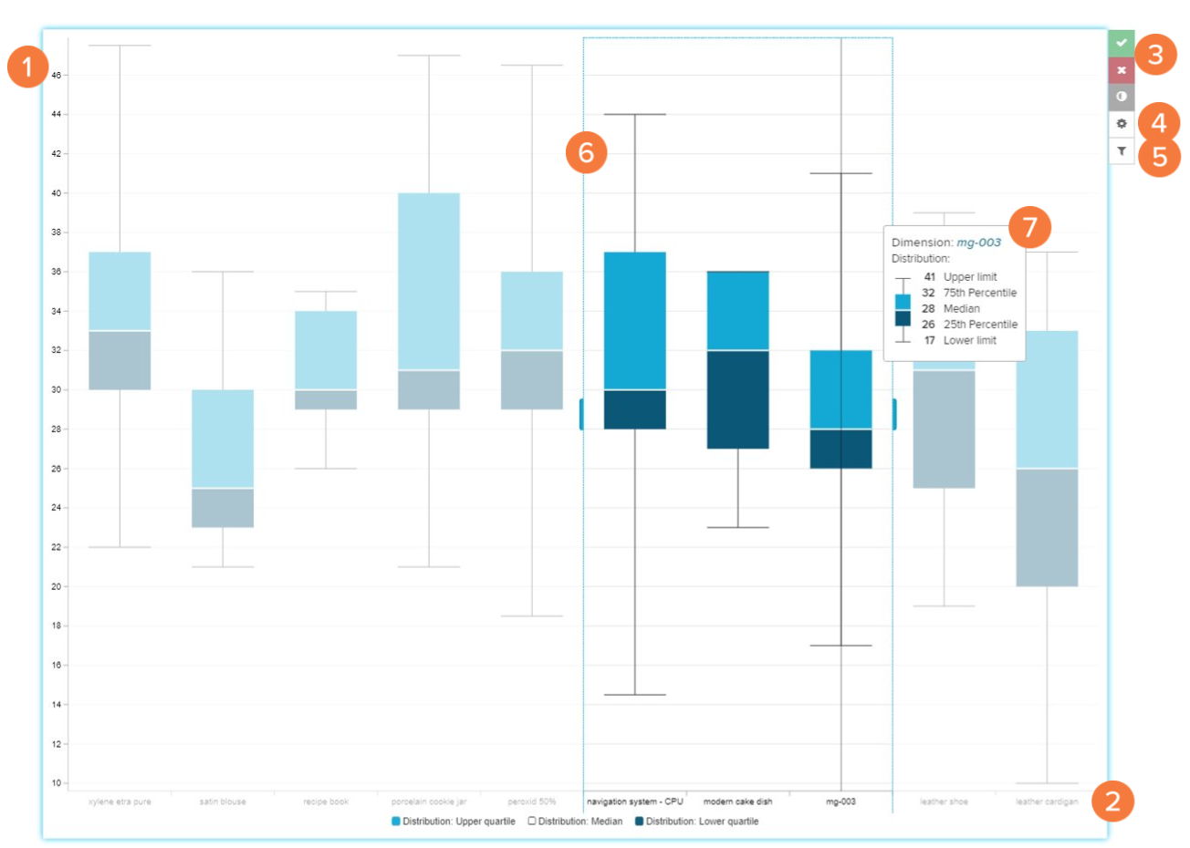
V. Challenge Tasks
Details
Chart Types
There are several chart types available in Celonis:
Column, line, area and marker charts
Pie and donut chart
Bubble plot
Histogram chart
Scatter plot
Boxplot
1
2
3
4
5
6

Slide 15
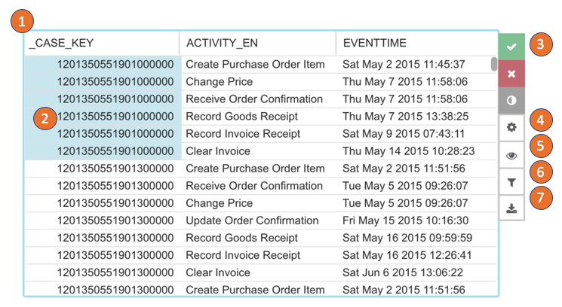
V. Preparation
Details
OLAP Table
The OLAP table shows all dimensions and KPIs configured in a table:
The dimension and KPI name are shown in the column headers. Click on the header to change the table sorting or search in the dimension columns.
Click on a dimension and create a selection. Selected entries can be copied to the clipboard by right click and the available action.
Confirm, cancel or invert the temporary selection.
Open the component settings. Hide and show dimensions and KPIs.
Hide and show dimensions and KPIs.
Open the component filter.
Download the component.
1
3
2
4
5
6
7

Slide 16

Sample
Workspace Structures
Notes:
Where can we get started
We’ve talked about how Celonis has helped companies like you to execute better and maximize capacity. Now let’s discuss where Celonis could help your organization improve execution.

Slide 17
Task 1: Variant Explorer
1. Variant Explorer
Pizzeria Mamma Mia
Delivery
#Orders
AVG Throughput Time
Header
Variant Explorer
Body

Slide 18
Task 2: Analysis
1. Overview Sheet: Costs
Pizzeria Mamma Mia
Delivery
#Orders
Total Profit
Total Costs
Header
Variant Explorer
OLAP Table: Customer Information
Body
Bar Chart; Customer Location, Customer Type

Slide 19
Task 3: Conformance Checking
1. Overview Sheet: Profit
Pizzeria Mamma Mia
Delivery
#Orders
Total Profit
Total Costs
Header
Variant Explorer
OLAP table: Costs, Revenue, Profit
Body
Bar chart: Costs overview e.g. time, factor, …

Slide 20
Conformance Checking
Notes:
Where can we get started
We’ve talked about how Celonis has helped companies like you to execute better and maximize capacity. Now let’s discuss where Celonis could help your organization improve execution.

Slide 21
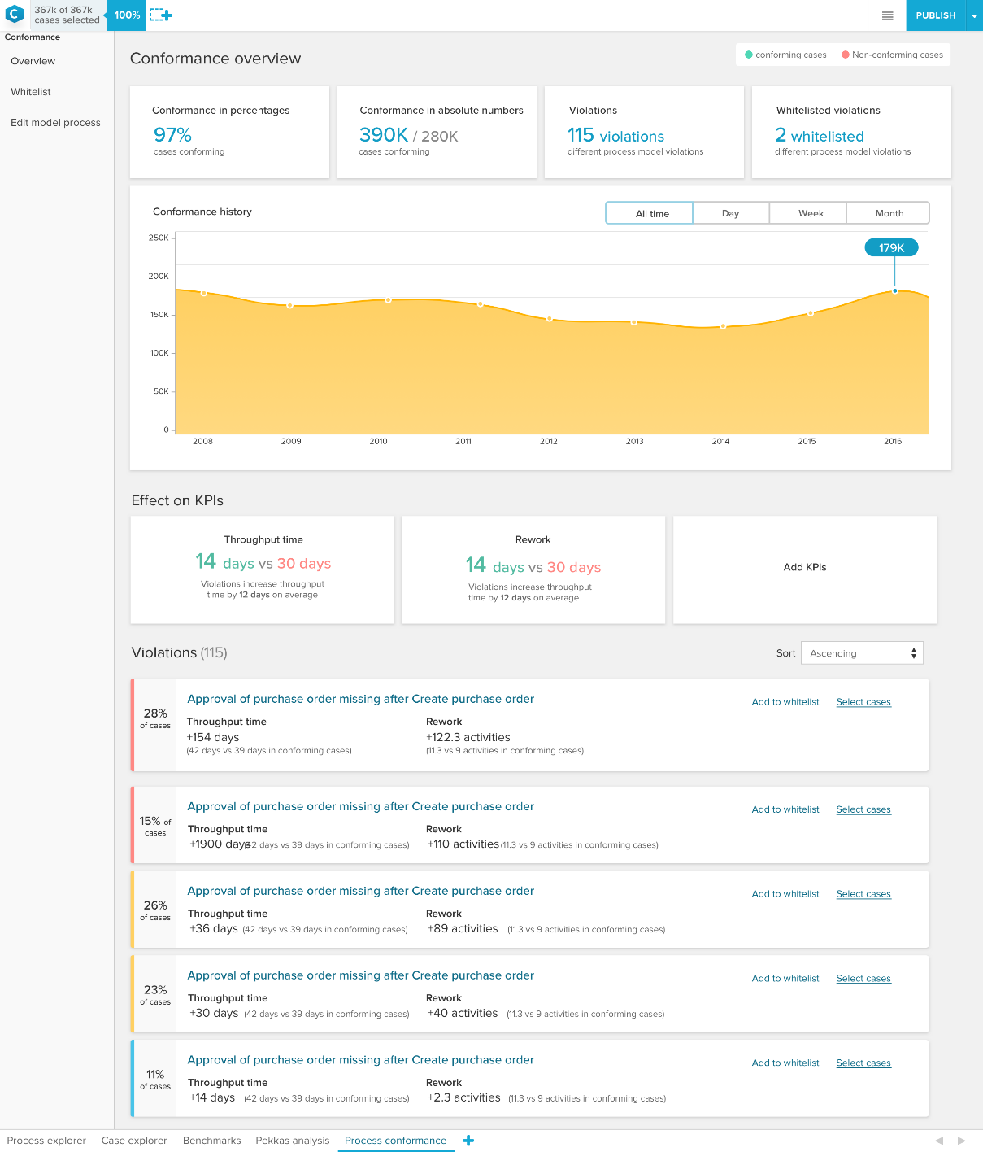
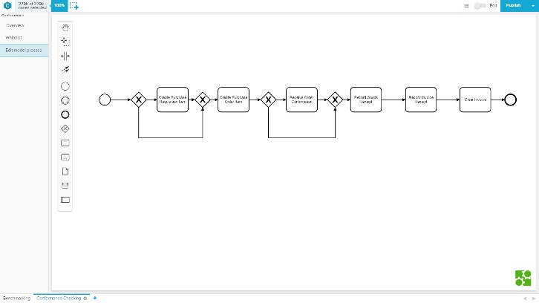

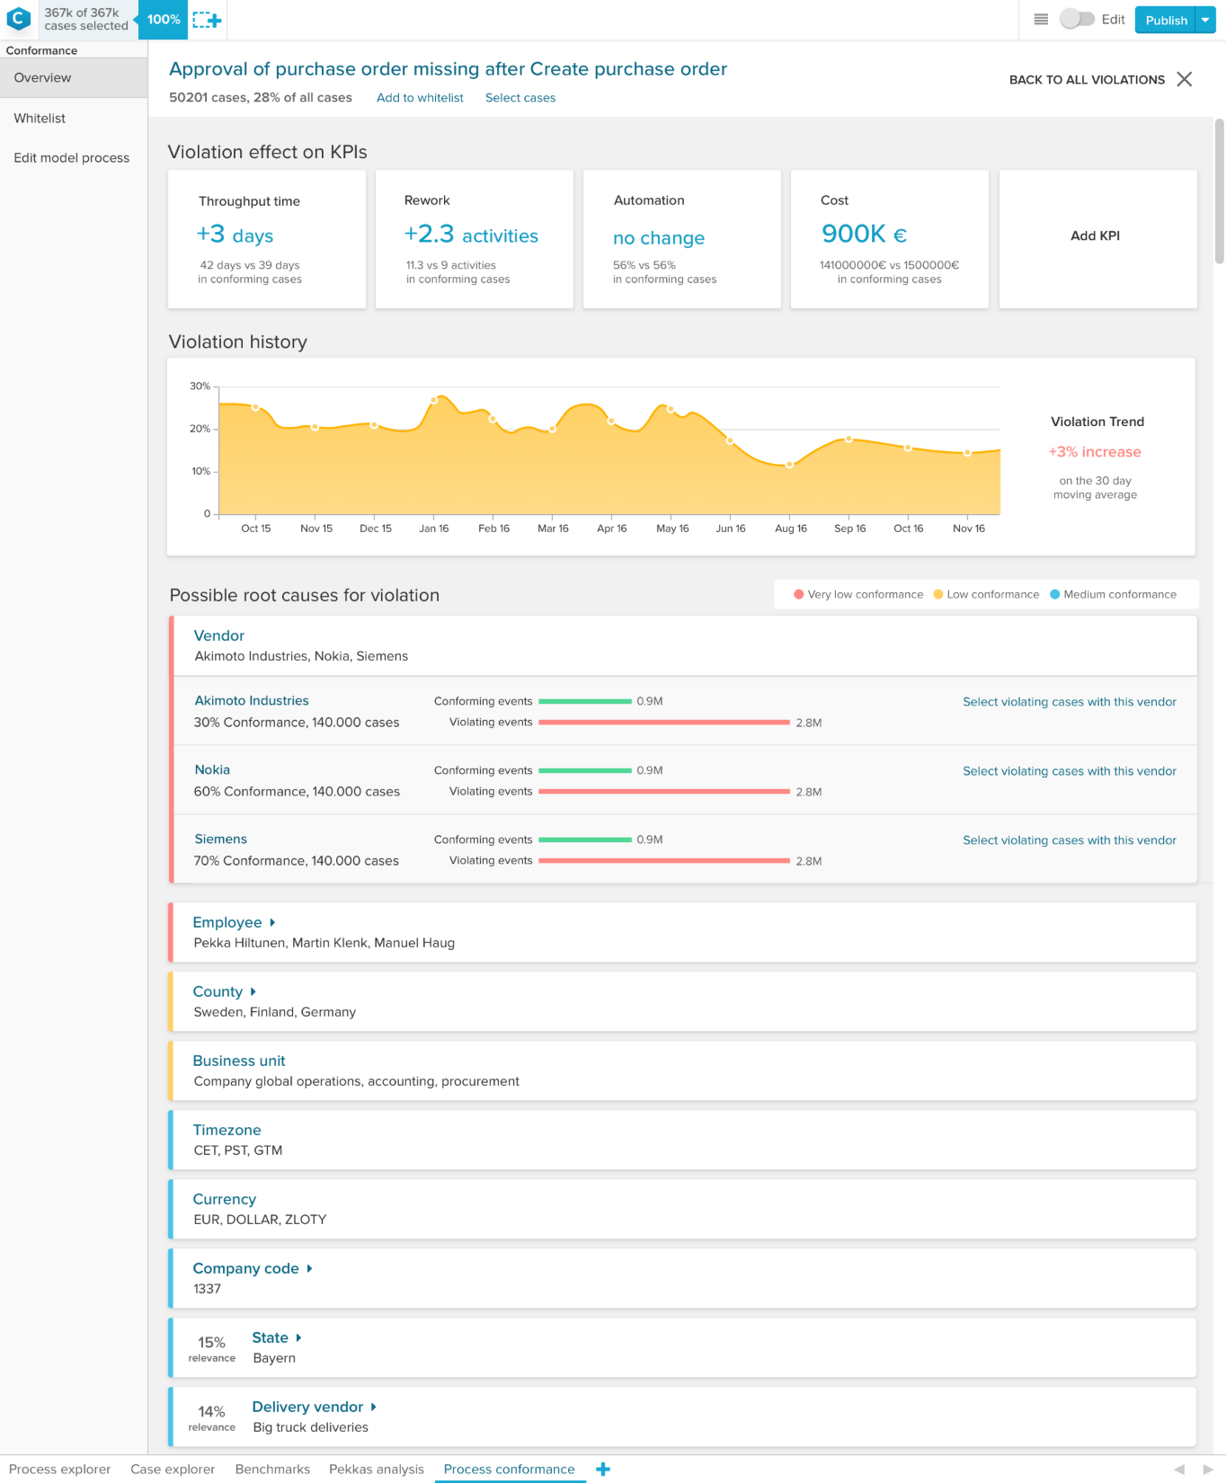
Task 3: Conformance Checking
Intelligent Conformance: Find and fix violations
Celonis PI automatically checks the desired process flow against the real one. PI Conformance shows how conformant your processes are, where violations occur, possible root causes, how to fix them, as well as conformance trends over time.
Import your process models
Download the exisiting process model that we have created for your here: https://bit.ly/2S0xIXU
Go to „Edit Process Model“ and upload your model.
Or create and edit process models yourself with the built-in Celonis Business Process Modeler.

Slide 22
Business Decision Making Group Presentation
Notes:
Where can we get started
We’ve talked about how Celonis has helped companies like you to execute better and maximize capacity. Now let’s discuss where Celonis could help your organization improve execution.

Slide 23
Pitch your findings
Your presentation should include:
Insights from the workspaces you created
Business recommendations for process improvement
An uploaded process model from the original business process

Slide 24


VI. Exercises – Pitch challenge
Pitching your analysis
Consider these types of questions:
1. Which variants have a negative impact on the On-Time Delivery and how do they look like?
2. What root causes can we identify that have a negative impact on customer satisfaction? How can we improve customer satisfaction?
3. What root causes can we identify that have a negative impact on profits? How can we increase profits?
https://bit.ly/celoniscase

Slide 25
Misc. +
Optional
Machine Learning
Notes:
Where can we get started
We’ve talked about how Celonis has helped companies like you to execute better and maximize capacity. Now let’s discuss where Celonis could help your organization improve execution.

Slide 26
Machine Learning App Creator Assignment est. time needed: 2 hours
Scenario: After your suggestions, Pizzeria Mamma Mia is optimizing their on-time delivery and quality. Well done! Now, the team has decided that the franchise would like to expand. However, with all the new purchasing of equipment, items, supplies, and more, one of the employees has noticed how long the p2p process is for Mamma Mia. For every free text inputted during Purchase Requisition process, it takes the new employee Caroline 15 minutes to match each free text to the catalogue item. It is wasting time and money that could be spent elsewhere. We can automate this process to save Caroline and Pizzeria Mamma Mia more time and money.
Assignment: In this task you will be asked to create a Machine Learning app and put it into operation using the Celonis guide. This app will address Pizzeria Mamma Mia’s pain points with indirect purchases by searching for past catalogue orders that have high similarity to the free text order. You can find your instructions in the following file path. https://www.dropbox.com/home/BOLT%20Challenge?preview=BOLT+Machine+Learning+Task.pptx

Slide 27
Example: Impact-Effort Matrix
Start with projects which require little effort, but highly impact the success of the company. Also scrap opportunities which are not feasible.
High
QUICK WINS
LONG TERM PROJECTS
1
Price Changes
1
2
…
5
4
Impact
Medium
NICE TO HAVE
NO GO's
2
3
6
Low
Low
Medium
High
Effort

Slide 28
Wrapping up
Once you have finished your work, you can email to e.Welshofer@celonis.de or to your BOLT representatives.
Happy Process Mining!

